Slide 1
INTRODUCTION TO JAVA SCRIPT
Unit 7

Slide 2
An HTML document is made up of HTML elements, HTML element attributes, comments, special characters, and doctype.
To add dynamic user experience (e.g. popup, alert message, animations etc.) to an HTML document we can add JavaScipt to our HTML document.

Slide 3
Javascript in HTML document
There are two general areas in HTML document where JavaScript can be placed. First is between <head>......</head> section, another is specific location in <body>......</body> section.
If we want to display a message 'Good Morning' (through the JavaScript alert command) at the time of page loading then we must place the script at the <head>......</head> section.

Slide 4
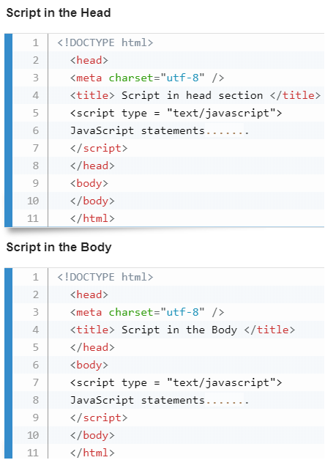

Slide 5
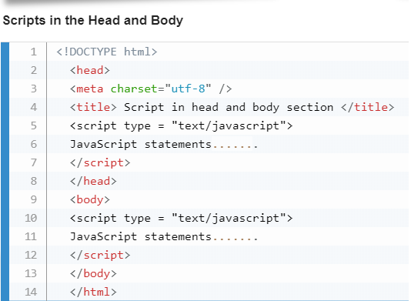

Slide 6
Variables in JavaScript
JavaScript Datatypes :One of the most fundamental characteristics of a programming language is the set of data types it supports.
These are the type of values that can be represented and manipulated in a programming language.
JavaScript allows we to work with three primitive data types −
Numbers, eg. 123, 120.50 etc.
Strings of text e.g. "This text string" etc.
Boolean e.g. true or false.

Slide 7
Like many other programming languages, JavaScript has variables. Variables can be thought of as named containers.
we can place data into these containers and then refer to the data simply by naming the container.

Slide 8
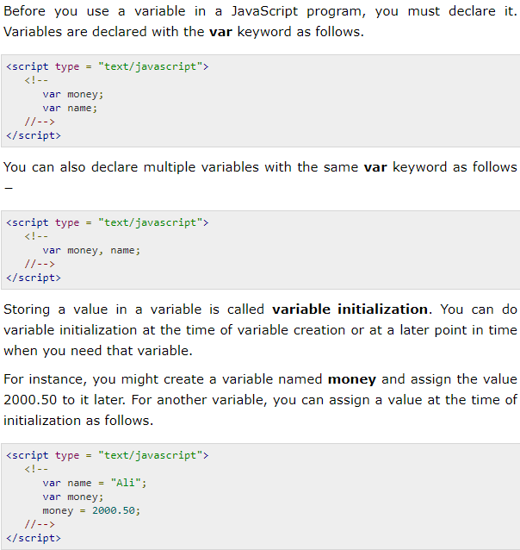

Slide 9
JavaScript Variable Scope
The scope of a variable is the region of your program in which it is defined.
JavaScript variables have only two scopes.
Global Variables − A global variable has global scope which means it can be defined anywhere in your JavaScript code.
Local Variables − A local variable will be visible only within a function where it is defined. Function parameters are always local to that function.

Slide 10
Within the body of a function, a local variable takes precedence over a global variable with the same name.
If we declare a local variable or function parameter with the same name as a global variable, we effectively hide the global variable.

Slide 11
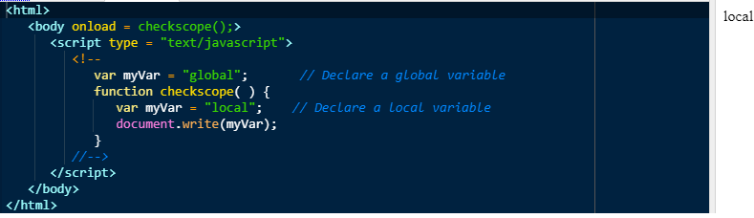

Slide 12
Rules for variable names
The first character must be a Letter, an underscore (_), dollar sign ($), or \ UnicodeEscapeSequence
A variable name cannot contain space character.
In JavaScript, variables are case sensitive, so emp_code is different from Emp_Code.
We should not use the "reserve words" like alert, var as a variable name.

Slide 13
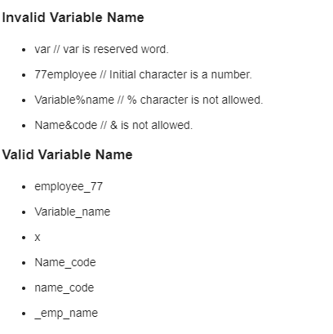
Example of variable name

Slide 14
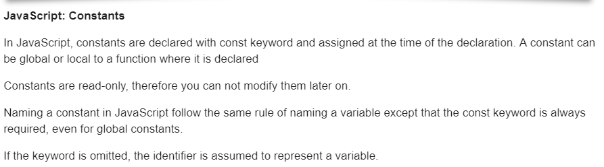
Constants in Java script

Slide 15
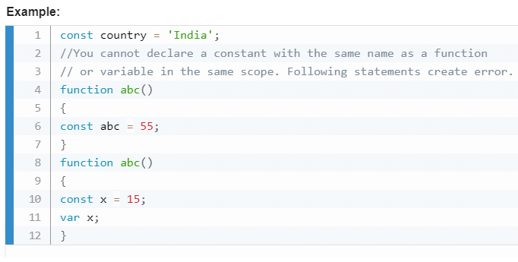

Slide 16
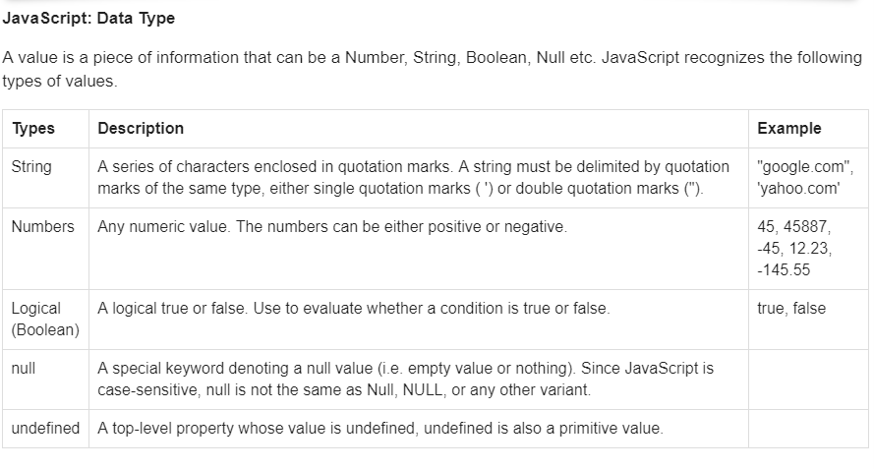

Slide 17
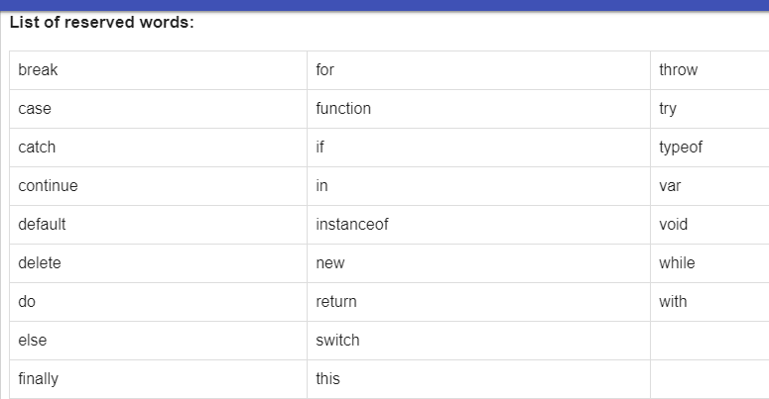

Slide 18
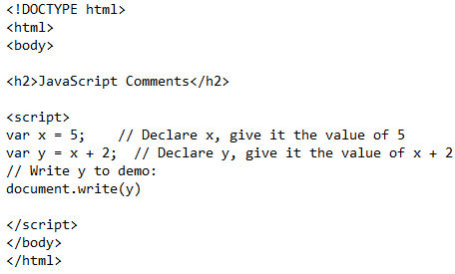

Single Line Comments
Single line comments start with //.
Any text between // and the end of the line will be ignored by JavaScript (will not be executed).
Output

Slide 19
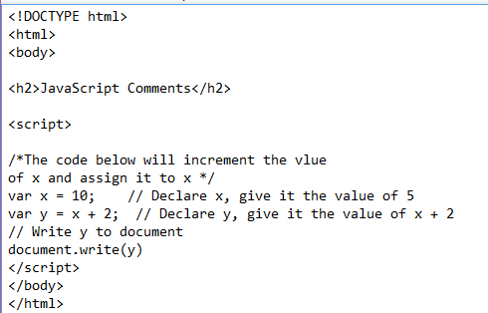
Multi-line Comments
Multi-line comments start with
/* and end with */
Any text between /* and */ will be ignored by JavaScript.

Slide 20
Operators in Javascript

Slide 21
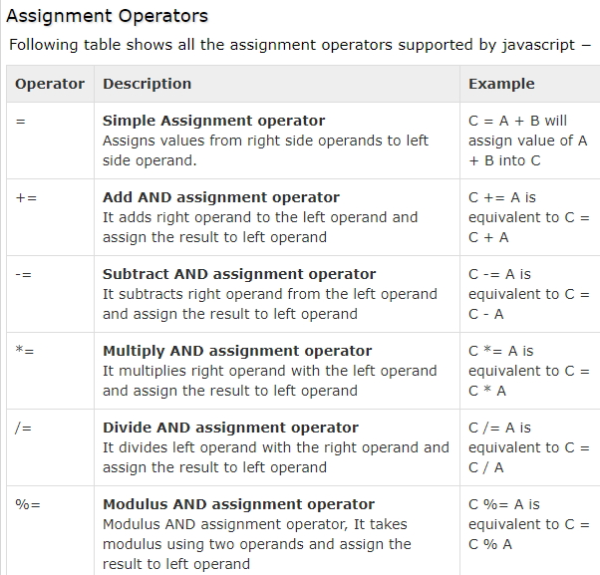
Assignment operator

Slide 22
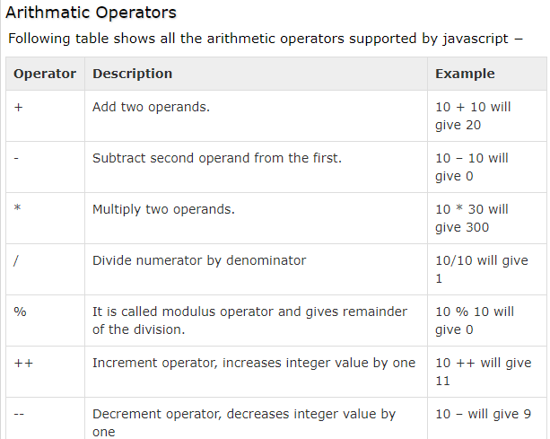

Slide 23
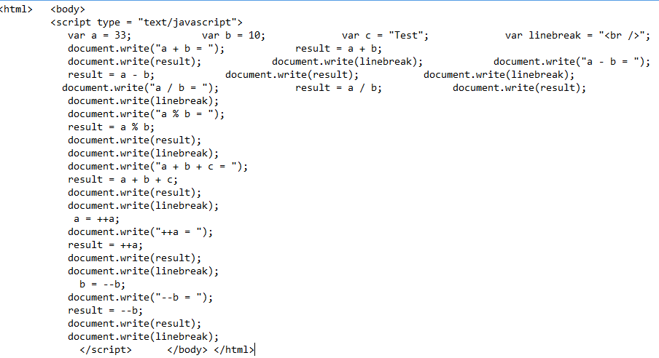
Demo of arithmetic operator

Slide 24
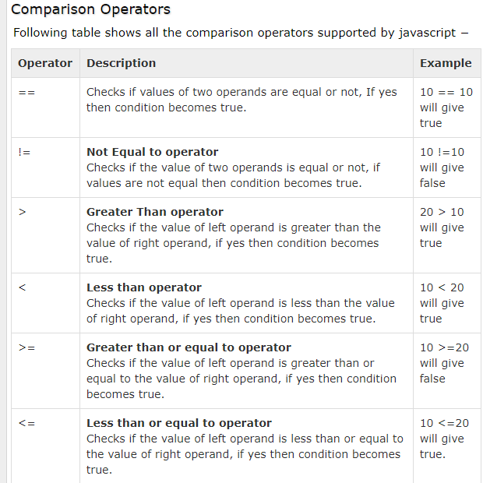
Comparison operator

Slide 25
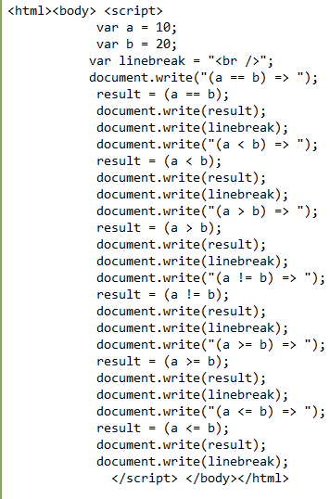
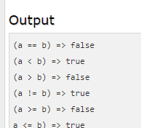
Demo of comparison operator

Slide 26
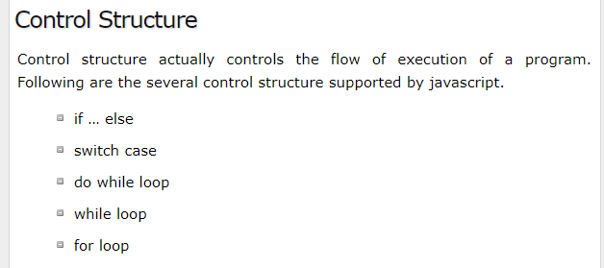

Slide 27
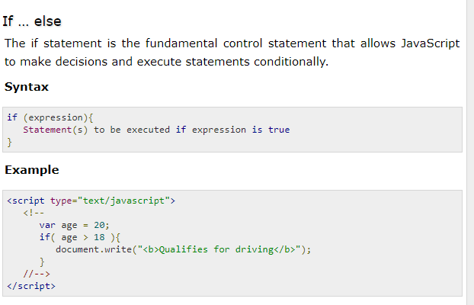

Slide 28
Switch case
The basic syntax of the switch statement is to give an expression to evaluate and several different statements to execute based on the value of the expression.
The interpreter checks each case against the value of the expression until a match is found. If nothing matches, a default condition will be used.

Slide 29
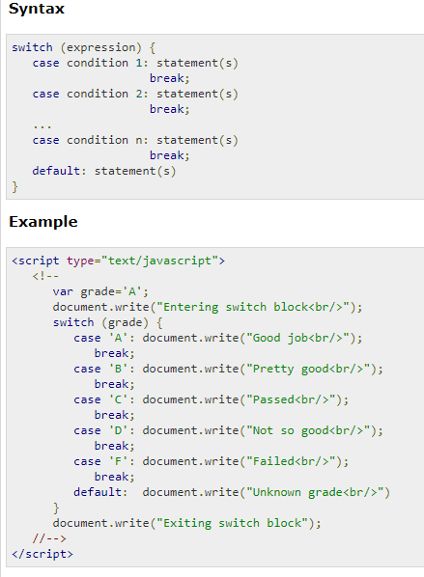

Slide 30
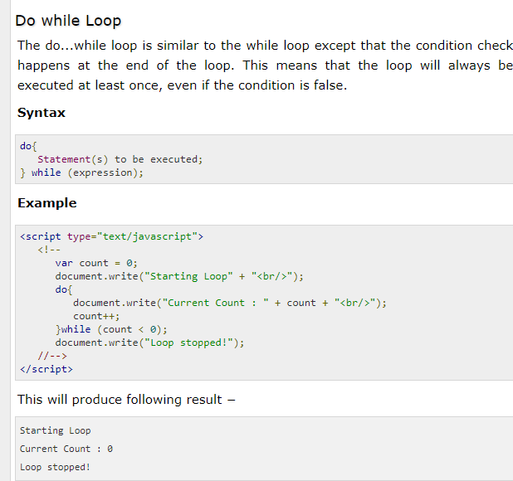

Slide 31
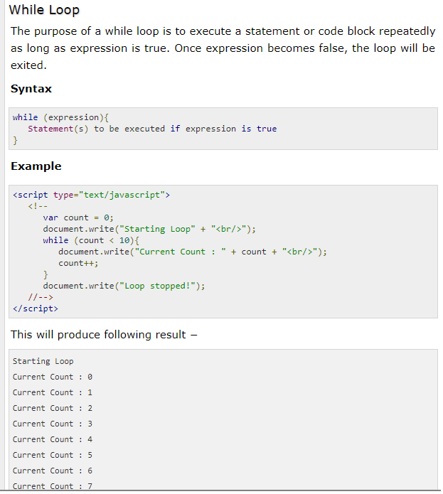

Slide 32
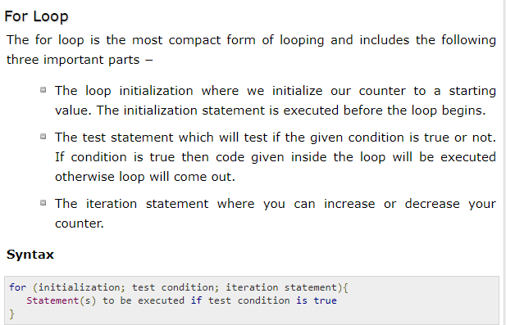

Slide 33
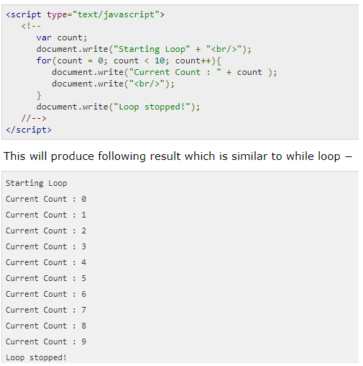

Slide 34
JavaScript Break and Continue
The break statement "jumps out" of a loop.
The continue statement "jumps over" one iteration in the loop.

Slide 35
The Break Statement
we have already seen the break statement used in an earlier chapter of this tutorial. It was used to "jump out" of a switch() statement.
The break statement can also be used to jump out of a loop.
The break statement breaks the loop and continues executing the code after the loop (if any)

Slide 36
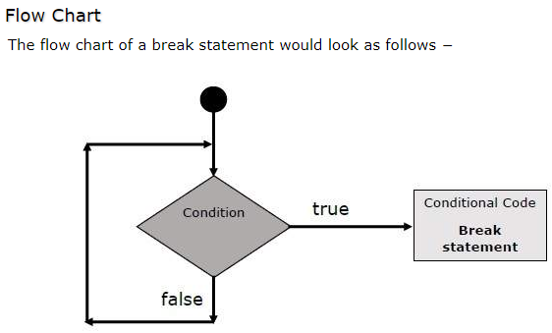

Slide 37
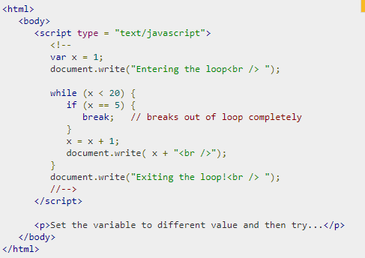
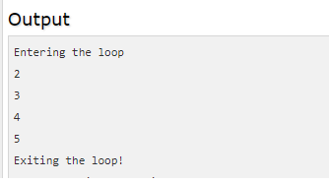

Slide 38
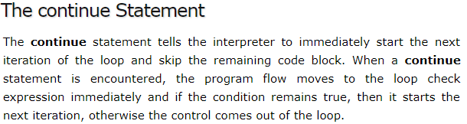

Slide 39
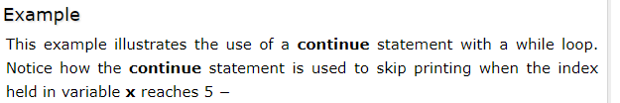

Slide 40
